Slide 1








BUSINESS INTELLIGENCE WITH POWER BI
Module 7: Loading, Modelling and Dashboards
The Power BI
Environment
Topic 1 of 6

Slide 2




MODULE 7 OBJECTIVES
Load, clean and model data correctly in Power BI
Write and verify essential DAX measures.
Design, present, and AI-check a KPI dashboard.
Define a capstone question and sign off a dataset.
Notes:
WHAT TO SAY (roughly two minutes):
"Welcome to Module 7. Before we start, I want to name where you are in this programme, because it matters for how this module is going to feel.
You are seven modules in. You have learned Excel, you have learned SQL, you have learned statistics, you have learned Python and pandas, and most recently you learned how to turn analysis into a story that a manager will act on. If you are feeling like every module brings another tool to learn, that is a reasonable thing to feel.
This module is different, and I want to promise you something at the start. Power BI is not a sixth subject. It is the first module where the things you already know get joined together into one job. By the end of today you are going to recognise almost everything on the screen, because you have already done it somewhere else. Where you see something new, I will tell you it is new."
WHY THIS FRAMING MATTERS: this point in the programme is where fatigue peaks and confidence dips. Trainees arrive braced for another unfamiliar interface. The most useful thing you can do in the first two minutes is remove that expectation, because a trainee who believes they are behind will not attempt the lab properly.
DELIVERY CUES:
- Do not open Power BI yet. Software on screen invites people to start clicking.
- Say the promise out loud. You will refer back to it on the translation slide and again in the recap.
TIMING: 2 minutes.
1

Slide 3


By the end of this topic, the trainee can…
▣
↓
⇄
Navigate
Load
Explain
the Power BI Desktop environment and name what each of the four views is for.
the SwiftRoute data through Power Query and apply transformations that survive a refresh.
how Power BI's pipeline mirrors the Excel and SQL workflows already learned.
Notes:
WHY THE OUTCOMES SLIDE IS NOT A FORMALITY: the programme's standard is that every slide, exercise and quiz item maps to a stated outcome, written as an observable action. Reading them aloud tells trainees exactly what they will be held to, which is a fairness issue as much as a pedagogical one.
Note the verbs: navigate, load, explain. Not "understand". You cannot observe understanding, only what someone can do with it.
WHAT TO SAY (about two minutes):
"Three things by the end of this topic.
First, you can move around Power BI Desktop and tell me what each of the four views is for.
Second, you can load data through Power Query and apply transformations that survive a refresh. That phrase, survive a refresh, is doing a lot of work and we will come back to it.
Third, and this is the one I care most about: you can explain how Power BI's pipeline mirrors the Excel and SQL workflows you already know."
READ OUTCOME THREE TWICE. It is the thesis of the entire module and the psychological strategy for the topic. Say the second reading slightly slower.
TIMING: 2 minutes.
4

Slide 4
Before we open anything
RETRIEVAL PRACTICE
Answer from memory. Notes closed. You have four minutes.
Write a SQL query that counts deliveries per route.
1
Module 3
In Power Query, what is the difference between removing a column and filtering a row?
2
Module 2
Name one thing that makes a chart dishonest.
3
Module 6
Notes:
WHAT THIS SLIDE IS DOING: retrieval practice, one of the nine teaching methods the programme mandates. It opens every concept session. Recalling from memory, effortfully, strengthens memory far more than re-reading does. It costs four minutes.
The three questions are not random. Each is a skill this topic is about to reuse under a different name:
- Q1 is a GROUP BY aggregation. In forty minutes they build the same thing by dragging two fields onto a canvas.
- Q2 is Power Query, from Module 2. Power BI's loading interface IS Power Query.
- Q3 is Module 6 chart judgement, the entire basis of Topic 7.4.
WHAT TO SAY (thirty seconds): "Notes closed, laptops closed. From memory. You will get some wrong and that is fine, the point is the trying. Four minutes."
EXPECTED ANSWERS:
1. SELECT RouteID, COUNT(*) FROM deliveries GROUP BY RouteID; Accept any working variant.
2. Removing a column deletes a field for every row, so you lose an attribute across the whole table. Filtering a row removes entire records failing a condition, so you lose observations. Common confusion: both "make the table smaller"; one narrows, one shortens.
3. Truncated y-axis, pie chart with too many slices, missing axis labels, inconsistent scales side by side, or a cherry-picked date range.
DELIVERY CUES: take answers verbally and quickly. Do not turn this into a SQL lesson. Call on at least one remote trainee by name. Correct in one sentence and move on.
TIMING: 4 minutes.
2

Slide 5
One screen answers her first three questions of the day
Every
morning
Adaeze Nwosu runs operations for SwiftRoute Logistics, a last-mile delivery firm working across Lagos, Ogun and Oyo.
1
Which routes slipped yesterday?
before the riders leave,
she opens one screen
2
Which riders are carrying the load?
3
Is the month still on track against the 90% promise?
She does not open Excel. She does not write a query. Someone built her a product, and it refreshes itself.
SwiftRoute is a composite training scenario built from realistic Nigerian last-mile operations. No real customer data is used.
Notes:
THE IDEA THIS SLIDE DELIVERS: there is a difference between producing an analysis and producing a product, and this module is about the second one.
Everything trainees have built so far has been an analysis: a one-off answer to a one-off question. Business intelligence produces something different. Adaeze opens it herself, filters it herself, drills in herself. You are not in the room and it keeps working.
WHAT TO SAY (about three minutes):
"I want to introduce you to someone you are going to spend two modules with. Adaeze Nwosu is the operations manager at SwiftRoute Logistics, a last-mile delivery company running out of Lagos into Ogun and Oyo.
Every morning, before her riders dispatch, she opens one screen and answers three questions. Which routes slipped yesterday. Which riders are carrying the load. And whether the month is still on track against the promise she made her clients, which is that ninety percent of deliveries arrive inside the window.
Notice what she does not do. She does not open Excel. She does not write SQL. She does not ring an analyst. Somebody built her a product, and it refreshes itself overnight."
THE QUESTION TO ASK: "Has anyone here ever been asked the same question three weeks in a row?" Most hands go up. Take one story briefly. It makes the problem personal before you offer the solution.
ON THE DISCLAIMER: read it aloud. It models the programme's responsible-data standard and sets up Topic 7.6, where trainees apply the same rule to their own capstone dataset.
TIMING: 3 minutes.
3

Slide 6
01
PART ONE
What Power BI actually is
Recognise the three stages you already know
See why BI is a product, not a one-off analysis
Learn the load order that saves you an hour
5
Notes:
WHAT TO SAY: "Part one. What this thing actually is."
Dividers exist so trainees, particularly remote ones who cannot read the room, know where they are in a long session.
TIMING: 30 seconds.
5

Slide 7
You already know all three stages
1. Power Query
2. Data model
3. Report canvas
◫
›
◇
›
▤
Module 2
Module 3
Module 6
Same tool. Literally the same interface as Excel.
Your joins, drawn as lines instead of written as SQL.
Your chart choice and labelling standards, applied directly.
Power BI is not a fifth tool. It is three things you can already do, joined into one window.
Notes:
THIS IS THE MOST IMPORTANT SLIDE IN THE DECK. If you deliver only one slide well, make it this one. Everything else in Module 7 is easier if this lands.
THE CONTENT IN FULL:
Stage one, Power Query. Not similar to Module 2's Power Query. The same software. Microsoft built it once and put it inside both Excel and Power BI. Same ribbon, same Applied Steps pane, same transformations, same underlying language. A trainee competent with it in Module 2 is competent with it here, and needs telling explicitly because the surrounding interface disguises it.
Stage two, the data model. In Module 3 they wrote joins in SQL. Here they drag one field onto another and a line appears. Same relational thinking, same consequences if wrong. The difference: in SQL you write the join every time; here you define it once and every visual uses it. That is an advantage, and also why a bad model poisons an entire report rather than one query.
Stage three, the report canvas. Every judgement from Module 6 applies unchanged. Power BI makes it easy to produce a chart and does nothing to make it honest. That judgement is still theirs.
WHAT TO SAY (about four minutes):
"Look at this diagram before I talk over it. Take ten seconds." [Pause. Let them read.]
"Three stages. Power Query, the data model, the report canvas. Now look at what is written underneath each one.
Power Query. You did this in Module 2, in Excel. And I do not mean something similar. I mean this exact tool.
The data model. This is your joins from Module 3. Same relational thinking, same consequences if you get it wrong. The one real difference: in SQL you write the join every time you need it, here you define it once and everything downstream uses it.
The report canvas. This is Module 6. Everything about chart choice and labelling applies unchanged. Power BI will make it very easy to build a chart. It will do absolutely nothing to stop you building a dishonest one."
Then the pull line, deliberately: "So: Power BI is not a fifth tool. It is three things you can already do, joined into one window."
COMMON QUESTION: "then why does Power BI exist?" Worth sixty seconds. Joining the three stages into one file, with the model in the middle, is what lets the report update itself. In Excel the three are loosely connected, so new data means redoing the chain by hand. Here the chain IS the file, so new data means pressing refresh.
TIMING: 4 minutes, 5 if that question comes up.
6

Slide 8
Analysis answers a question. BI answers it every morning.
AN ANALYSIS
A BI PRODUCT
Answers one question at one point in time
Answers a standing set of questions
Lives in a file that you send to someone
Lives at a link the manager opens herself
Goes stale the moment new data arrives
Refreshes against the source and stays current
You are the interface: they ask, you run it
The model is the interface: they explore without you
Both are legitimate work. This module teaches the second one.
Notes:
THE CONTENT IN FULL: walk the four contrasts; each has a practical consequence.
One question versus a standing set: an analysis is commissioned and finished. A dashboard is built for questions that recur, the same three things every morning. That changes what you build for.
A file you send versus a link she opens: a file that has been emailed has forked. Two versions that diverge. Within a month there are eleven versions in an inbox and nobody knows which is current. A link has one version.
Goes stale versus refreshes: an Excel analysis is a photograph of the data at the moment you did the work. A dashboard is connected to the source and can be told to look again.
You are the interface versus the model is the interface: the deepest of the four. When you are the interface, the organisation's ability to ask questions is limited by your availability. When the model is the interface, Adaeze can ask a question you never anticipated, at ten at night, and get a correct answer.
THE CAVEAT, WHICH MUST BE SAID: do not let trainees leave thinking dashboards are superior to analysis. A dashboard nobody opens is worth less than a one-page memo that changed a decision. Say: "I am not telling you dashboards are better. They are different. What I am telling you is that this is a second thing you can now produce."
This nuance returns in Topic 7.4, where a visual that does not support a decision should be deleted.
TIMING: 3 minutes.
7

Slide 9
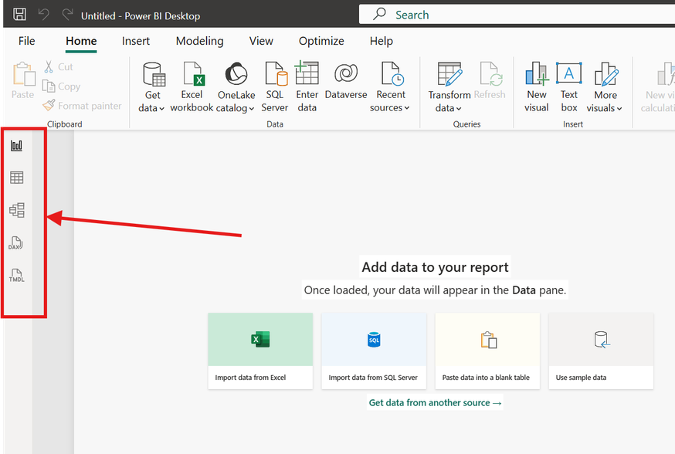
Four views, one file
Report view
1
Where you build what Adaeze sees.
Table view
2
Where you inspect the data as rows, the way you would in Excel.
Model view
3
Where relationships are drawn. This is Topic 7.2.
Power Query editor
4
A separate window. Where cleaning happens before anything else.
Notes:
PURPOSE: orientation only. You are not teaching any of the four views here. You are making sure that when you say "go to Model view" in forty minutes, nobody is lost. Resist the urge to teach.
THE CONTENT IN FULL:
Report view is the default, the canvas where visuals go, with a Fields pane and a Visualisations pane.
Table view shows one table at a time as rows and columns, exactly like a spreadsheet. Its purpose is inspection: when a measure returns an unexpected number, this is where you come to look at the actual data. Flag that this is the verification surface Topic 7.3 depends on.
Model view shows tables as boxes with lines between them. That is the whole of Topic 7.2; say almost nothing else now.
The Power Query editor opens as a SEPARATE WINDOW, not a fourth icon in the rail. This single confusion accounts for a surprising share of lab interruptions.
WHAT TO SAY AND DO (about three minutes): switch to Power BI with the fallback file already open.
"Four things to know about where you are. I am going to click each one, tell you what it is for, and then click away. We are not learning any of these yet.
Report view. Blank canvas, charts go here. Table view. One table as rows, exactly like a spreadsheet. Come here when a number looks wrong. Model view. Boxes and lines, the whole of the next topic. And Transform data, which opens Power Query. Watch what happens to my screen."
[Click it. Let the separate window open.]
"Separate window, not a tab. If you lose Power BI during the lab, check your taskbar before you put your hand up."
TIMING: 3 minutes.
8

Slide 10
Clean first. Model second. Visualise last.
1
Transform
›
2
Relate
›
3
Visualise
in Power Query
in Model view
in Report view
Reversing this order is the most expensive mistake in BI. Every visual you build on a badly shaped table has to be rebuilt when you fix the shape. Trainees who skip Power Query lose an hour in the lab and blame the software.
!
The tool rewards doing this in the wrong order. The discipline has to come from you.
Notes:
THE CONTENT IN FULL: the three stages must happen in order because each depends on the shape produced by the one before. Cleaning first costs fifteen minutes before anything interesting appears. Cleaning last costs an hour of rework under time pressure, which is when mistakes get made.
There is a psychological problem worth naming: Power BI is genuinely fun in Report view, a chart appears in eight seconds. Power Query is a list of steps and a grey preview grid. The software rewards doing this in exactly the wrong order.
WHAT TO SAY (about three minutes):
"One rule for this whole module, and it is the rule most beginners break. Clean first. Model second. Visualise last.
Suppose you build a beautiful chart, then discover your date column came in as text. You fix the type, and now every visual using that field has to be checked and usually rebuilt. You have paid twice.
Now here is what I actually want to warn you about. Power BI is genuinely fun in Report view. Power Query is not fun. So the software is going to reward you for doing this in exactly the wrong order. Within thirty seconds of opening a file you will want to drag something onto a canvas. Do not.
And you already know this rule. It is the same rule as Module 2: clean before you analyse."
COMMON OBJECTION: "But my file is already clean." Answer: you do not know that until you have looked, and looking happens in Power Query. Topic 7.2 has a worked example where a single trailing space breaks a relationship with no error message.
TIMING: 3 minutes.
9

Slide 11
02
PART TWO
Loading SwiftRoute
Meet the five files and the idea of grain
Load through Power Query, step by step
Write rules that survive next month's file
5
Notes:
WHAT TO SAY: "Part two. Let us actually load something."
TIMING: 20 seconds.
10

Slide 12
Five files, one business
FACT TABLE
swiftroute_
deliveries.csv
riders.csv
routes.csv
customers_
business.csv
dates.csv
41,280 rows
68 rows
24 rows
310 rows
365 rows
one row per delivery, 2025
one row per rider
one row per route
one row per business account
one row per day
Say the grain of a table out loud before you use it. “One row per what?” is the question that prevents most modelling errors.
Notes:
THE CONTENT IN FULL: introduce the five files and, more importantly, the concept of GRAIN.
The grain of a table is the answer to "what does one row represent?" It sounds too simple to need a name, and it is the single most useful habit in data modelling. Almost every serious modelling error traces back to using a table without knowing its grain.
- swiftroute_deliveries: one row per delivery, 41,280 across 2025, carrying rider, route, customer, promised time, actual time, fee and status.
- riders: one row per rider, 68.
- routes: one row per route, 24.
- customers_business: one row per business account, 310. Business accounts only, no individuals, which is the programme's responsible data standard visible in the design of the material.
- dates: one row per calendar day, 365.
Grain matters concretely in Topic 7.2, where counting rows in a delivery-grain table gives 41,280 riders instead of 68. Install the habit now, before they see the failure, so the failure means something.
WHAT TO SAY (about four minutes):
"Five files. I want to teach you a word first: grain. The grain of a table is the answer to one question. One row per what?
Deliveries. One row per delivery. Forty-one thousand two hundred and eighty across 2025.
Riders. One row per rider. Sixty-eight.
Routes. One row per route. Twenty-four.
Customers. One row per business account. Three hundred and ten. And notice: companies, not people. No individual names, no phone numbers. That is deliberate, and it is the same rule you will apply to your own capstone dataset.
Dates. One row per day. Three hundred and sixty-five.
Now that word. Grain. Say it with me: one row per what."
DELIVERY CUES: actually make them say it. Point out there are no lines connecting these tables yet; that is the next topic.
TIMING: 4 minutes.
11

Slide 13
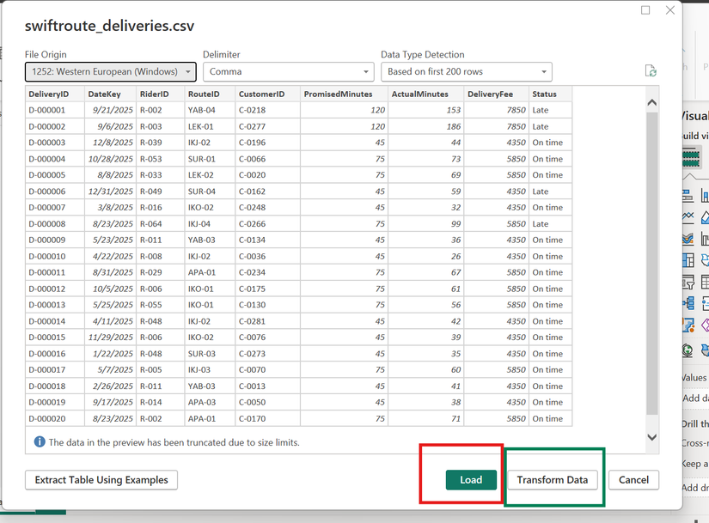
Loading SwiftRoute: steps 1 and 2
1
Get data
2
Preview
3
Transform
4
Check
5
Close and apply
Step 1
Home, Get data, Text/CSV. Point at the file. Power BI reads it but does not commit.
Step 2
The preview offers two buttons and the choice matters. Load takes the file exactly as it is. Transform data opens Power Query first.
Always choose Transform data. Always.
Notes:
THE CONTENT IN FULL: the mechanics are trivial; the decision at step 2 is not.
When you point Power BI at a CSV, it shows a preview and offers Load and Transform data.
Load takes the file as Power BI guessed it. Power BI is quite good at guessing, and "quite good" is the problem. It infers types by sampling the top of the file, so a column that is numeric for 200 rows and contains "N/A" at row 4,000 will be mistyped and produce errors later, far from the cause.
Transform data opens Power Query first, so you can correct before anything downstream exists. Correcting there is free.
The rule: always choose Transform data. Not usually. Always. Thirty seconds on a genuinely clean file, and the benefit is that you actually looked.
WHAT TO SAY AND DO (about three minutes), demo live, narrating reasoning not clicks:
"Home ribbon, Get data, Text or CSV. I point at swiftroute deliveries.
Now it shows me a preview with two buttons, and this is the only interesting moment in the whole process. Load takes the file exactly as Power BI guessed it, and it is quite good at guessing. That is the problem: it looks at the first couple hundred rows and infers types from those.
Transform data opens Power Query first. Nothing is committed. I get to look at what it guessed and fix it while fixing is free.
So I am choosing Transform data, and notice why: not because this file is dirty, but because I have not yet looked at the column types."
DELIVERY CUES: "I am choosing X because Y" is the think-aloud pattern the programme asks for. Keep the fallback file open in another window.
TIMING: 3 minutes.
12

Slide 14
Four transformations, recorded as steps
1
Get data
2
Preview
3
Transform
4
Check
5
Close and apply
1
Promote headers
if Power BI did not do it for you
WHY IT MATTERS
Every action is recorded as a named step in the Applied Steps pane. The list can be reordered, individual steps deleted, and each one clicked to see the table as it stood at that moment.
That is what makes this a pipeline rather than a clean-up. In Excel the work is gone once done. Here the work is a recipe, and the recipe can be run again on a different file.
2
Set data types explicitly
DeliveryDate to Date, DeliveryFee to Fixed decimal, RiderID to Text
3
Trim whitespace
on RiderID and RouteID. Trailing spaces break relationships silently
4
Filter test rows
where CustomerID is blank
Notes:
THE CONTENT IN FULL, four transformations each with a reason:
1. Promote headers. Power Query usually does this. If not, columns are named Column1, Column2 and the row count reads one too high.
2. Set data types explicitly. Dates to Date, money to Fixed decimal number (avoids floating-point rounding on currency), identifiers to Text (its own slide follows).
3. Trim whitespace on key columns. A trailing space is invisible on screen and fatal to a relationship, because "R-014 " and "R-014" are different strings. Nothing turns red; the join just produces blanks.
4. Filter the blank-CustomerID rows. Phrase it as a condition, "where CustomerID is blank", not a position, "delete rows 4,112 to 4,114". The first is a rule that applies correctly to next month's file.
THE APPLIED STEPS PANE is the real content of this slide: every action recorded as a named, reorderable, reversible step. That is what makes the work a pipeline.
WHAT TO SAY AND DO (about four minutes): demo each transformation, then point at the Applied Steps pane. "Source. Promoted Headers. Changed Type. Trimmed Text. Filtered Rows. I can click any one and see the table at that moment. I can reorder them."
THE DELIBERATE MISTAKE: apply the filter before setting types, watch it behave oddly, drag Filtered Rows below Changed Type, watch it correct. Say: "that is why the steps being reorderable matters. I got the order wrong and it cost me one drag."
TIMING: 4 minutes.
13

Slide 15
An ID is a label, not a quantity
WRONG · Whole number
RIGHT · Text
RiderID stored as Whole number. Power BI will happily sum it.
RiderID stored as Text. It cannot be summed.
89,712
68
The total of your rider IDs. It means nothing.
It can be counted, grouped and joined, which is all you want from an identifier.
The same reasoning applies to phone numbers, account numbers, BVN and postcodes.
Notes:
THE CONTENT IN FULL: an identifier looks like a number and is not one. The test is whether arithmetic on it means anything. Rider 14 plus rider 22 is not rider 36.
When typed as a whole number, two things follow. Power BI auto-sums it the moment it is dragged into a visual, producing an arithmetically correct and semantically meaningless total. And leading zeros are stripped, so "007" becomes "7", breaking a relationship against a table that kept it as text.
WHAT TO SAY (about two minutes):
"Rider ID to Text. Here is the test: does arithmetic on it mean anything? Rider fourteen plus rider twenty-two is not rider thirty-six.
Two things go wrong if you type it as a number. First, Power BI auto-sums it, and your report gets a total row saying eighty-nine thousand seven hundred and twelve, which is perfect arithmetic and completely meaningless. Somebody will read it.
Second, leading zeros disappear. Zero zero seven becomes seven. And if your other table kept it as text, your relationship now matches on some rows and silently fails on others.
Same reasoning for phone numbers, account numbers, BVN, postcodes. Anything that looks like a number and is actually a name."
A QUESTION WORTH ASKING: "Has anyone here ever seen a report with a total row that summed an ID column?"
TIMING: 2 minutes.
14

Slide 16
The question that separates a pipeline from a clean-up
Next month Adaeze sends a new file: same columns, different rows. You press Refresh. What survives?
A RULE
AN EDIT
“Remove rows where CustomerID is blank”
“Delete rows 412 to 415”
Describes a condition. True of any file. Survives the refresh.
Describes a position. True of this file only. Next month it silently deletes four innocent deliveries.
Write rules, not edits.
Notes:
THE CONTENT IN FULL: this is the intellectual core of Power Query. Every transformation is either a RULE, a condition true of any file with this structure, or an EDIT, a fact about this particular file.
Rules survive a refresh. Edits do not, and worse, they do not FAIL on refresh. They apply confidently to the wrong rows. "Delete rows 412 to 415" will happily delete four perfectly good deliveries next month with no warning.
This principle carries into Module 8, where the topic on automating repetitive analyst tasks is this idea at a larger scale.
WHAT TO SAY (about three minutes):
"Here is the question to ask about every step you write in Power Query. Next month, Adaeze sends a new file. Same columns, different rows. You press Refresh. What survives?
If what you built was a pipeline, everything survives. Types, trims, filters, and every chart downstream. Zero work, current report.
If what you built was a clean-up, you start again.
So the test: does this step name a condition or a position? Remove rows where Customer ID is blank, that is a rule. Delete rows four one two to four one five, that is not. And here is what makes it dangerous: next month it will not fail. It will not warn you. It will confidently delete four innocent deliveries and tell you nothing.
Write rules, not edits."
DELIVERY CUES: stress that a bad edit does not fail loudly. Trainees assume errors announce themselves; most expensive ones do not. Flag forward to Module 8's automation topic.
TIMING: 3 minutes.
15

Slide 17
Load routes.csv
8 min
YOUR TURN
Load routes.csv into Power BI through Power Query. Set RouteID to Text, DistanceKm to Decimal number, and trim whitespace on RouteID. Close and apply.
EXPECTED OUTPUT
24 rows, 6 columns, no error indicators in the Applied Steps pane, and RouteID showing the ABC text icon in the column header.
Compare with the person next to you before you ask me.
Notes:
WHY THE EXPECTED RESULT IS STATED: expected-output verification is one of the programme's nine teaching methods, treated as an assessed professional skill. Never set a task without a checkable result.
WHY PAIRS: guided and semi-guided exercises run in rotating pairs, one driving the keyboard, one navigating from the instructions.
WHAT TO SAY (one minute, then eight minutes of work):
"Eight minutes. Load routes dot csv, set Route ID to Text, Distance in kilometres to Decimal number, trim whitespace on Route ID, close and apply.
You should end with twenty-four rows, six columns, no error markers, and Route ID showing the little ABC text icon.
If your numbers do not match, check with the person next to you before you put your hand up."
WHAT TO DO: walk the room. Do not answer from the front.
PROBLEMS TO EXPECT:
- 25 rows instead of 24: headers not promoted.
- Errors on DistanceKm: regional locale reading the decimal separator differently. Fix with Change Type using Locale.
- RouteID still a number icon: wrong column typed, or a later step reverted it.
TIMING: 8 minutes plus 1 minute instruction.
16

Slide 18
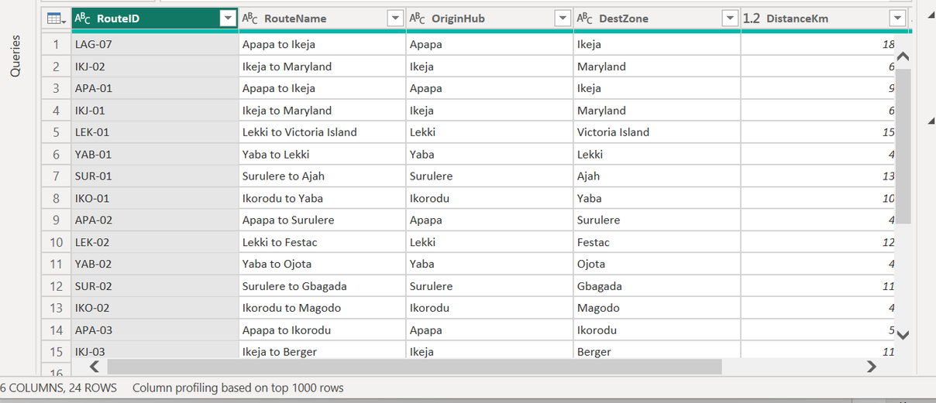
Solution: routes.csv loaded
24 rows, as stated. If you have 25, the header row was not promoted.
✓
RouteID must be text. If it shows a number icon, the relationship in Topic 7.2 will fail, and it will fail silently.
✓
DistanceKm errors? Your locale is reading the decimal separator differently. Change the type using Locale.
✓
Notes:
HOW TO RUN THE REVEAL: show the finished state, then walk the three failure modes. The trainees who got it right do not need you; the ones who did not need the diagnosis.
WHAT TO SAY (about two minutes):
"Twenty-four rows, six columns, Route ID as text. Three ways this goes wrong.
Twenty-five rows means your headers were not promoted.
Route ID showing a number icon is the one to take seriously: it will not hurt you today, it will hurt you in about forty minutes when we build relationships, and it will hurt you silently.
And if Distance in kilometres is throwing errors, that is your machine's regional settings disagreeing with the file about the decimal point. Change Type using Locale."
TIMING: 2 minutes.
17

Slide 19

Topic Recap
Navigate Power BI Desktop and say what each of the four views is for.
✓
Load a file through Power Query and apply transformations recorded as reorderable, refreshable steps.
Up Next: Data Modelling
✓
Explain why the Power BI pipeline is the Excel and SQL workflow you already knew, rebuilt in one window.
✓
Nothing in this topic was new. That was the point.
Notes:
Restating outcomes as achievements is required by the deck anatomy in the Content Creator Guide. The phrasing shift from "the trainee can" to "you can now" closes a loop the trainee can feel.
WHAT TO SAY (about two minutes):
"Three things you could not do ninety minutes ago. You can move around Power BI Desktop and tell me what the four views are for. You can load a file through Power Query and apply transformations recorded as steps, reorderable, reversible, surviving next month's file. And you can explain why this is the Excel and SQL workflow you already knew, rebuilt in one window.
And I want to say the last thing honestly. Nothing in this topic was new. Power Query you had in Module 2. Cleaning before analysing you had in Module 2. The relational thinking is Module 3. That was the point. This is the topic where your separate subjects turn into one job."
TIMING: 2 minutes.
18

Slide 20
What is Next
STRAIGHT INTO 7.2
IN THE LAB
ON PUBLICA.ACADEMY
◇
▣
?
You have five loaded tables sitting next to each other with no relationships. Next you find out what happens when you try to use them that way.
Load all five SwiftRoute files, fix a deliberately broken query, and reorder Applied Steps to repair a transformation that runs in the wrong order.
Practice questions on Power Query step order and data types, plus the Module 7 mini project brief.
Notes:
HOW TO END: on the teaser in card one, without spoiling it. Topic 7.2 opens with a demonstration of a dashboard reporting 41,280 riders when the company has 68, and it only works if trainees do not see it coming. It is the strongest teaching moment of the module.
WHAT TO SAY (about one minute):
"Straight into 7.2 after the break. You have five tables loaded, sitting next to each other, with nothing connecting them. In the next topic I am going to show you what happens when somebody solves that the obvious way, by joining everything into one big table before importing it. It loads perfectly. Every chart builds. No errors anywhere. And it produces a number that is completely wrong, on a chart that has a title and an axis label and a legend."
DELIVERY CUE: do not say what the number is or why. The whole of 7.2 depends on holding that tension.
TIMING: 1 minute.
19

